Slide 1

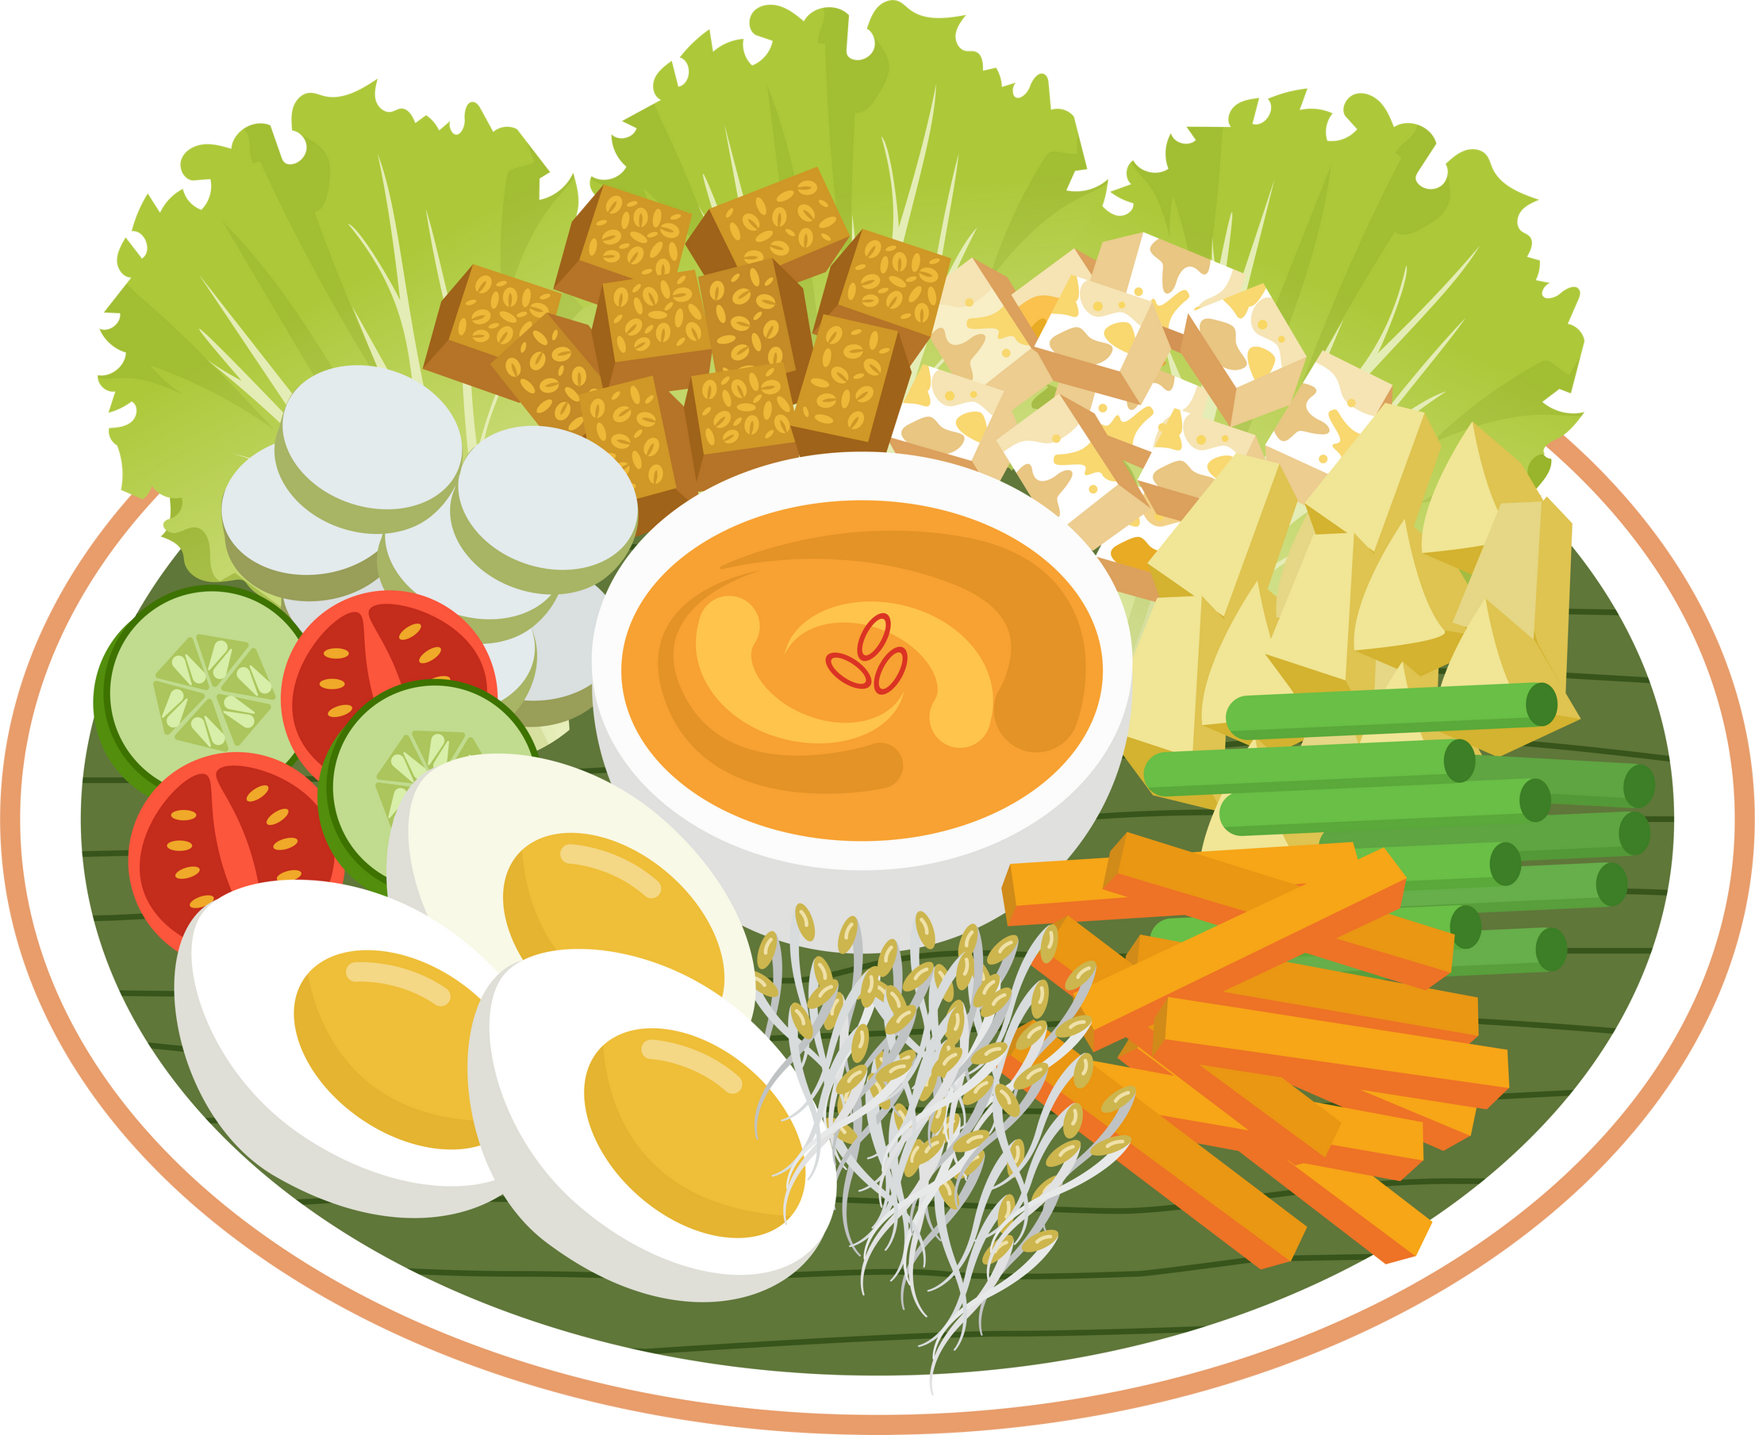
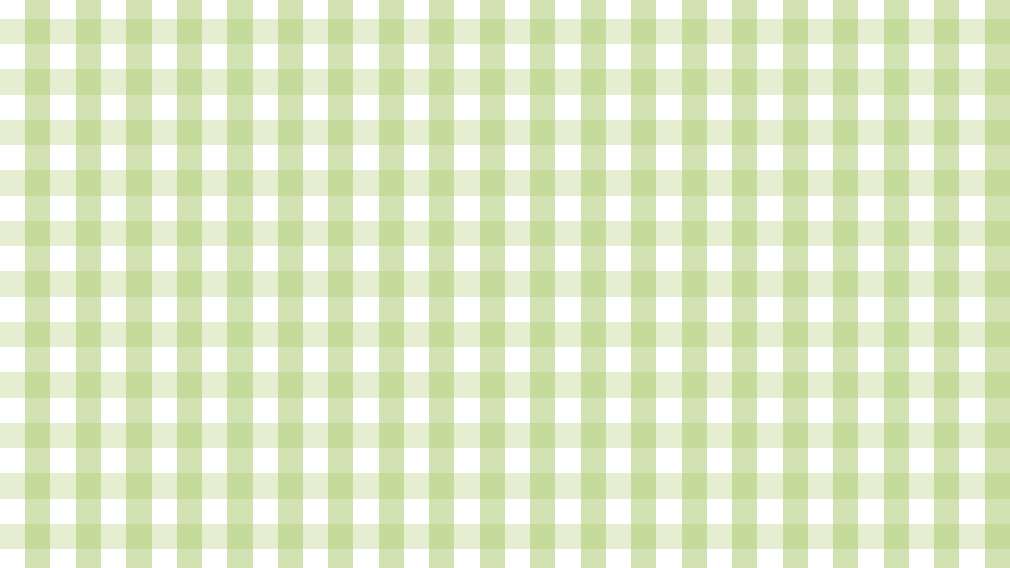


AI-POWERED PERSONALIZED MEAL PLANNER
DATA 606: CAPSTONE IN DATA SCIENCE
Presented by: Madhu Priya P
Under the Guidance of Dr. Chaojie Wang

Slide 2





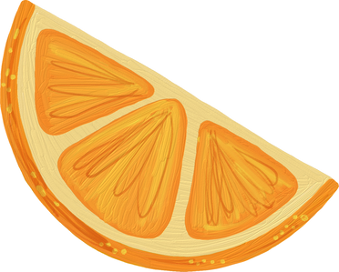
INTRODUCTION
  The AI-Powered Meal Planner generates personalized daily meal plans based on calorie needs and nutritional goals.
  Uses unsupervised learning (clustering) to group foods into meaningful nutritional categories.
  Employs a OLLAMA to generate customized meal plans, recipes, and grocery lists.
  Outputs include recipe suggestions, grocery lists, and a macros donut chart for balanced nutrition.

Slide 3


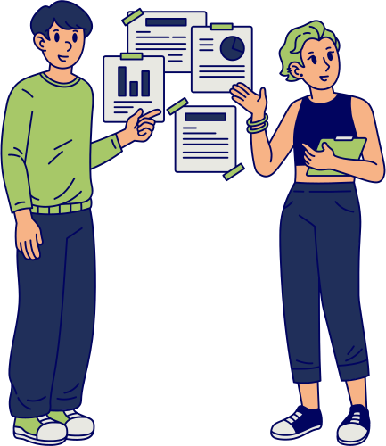


RESEARCH QUESTIONS
How can clustering group foods by nutritional similarity?
Can an LLM generate meal plans aligned with macro goals?
How can we make it actionable for users?

Slide 4
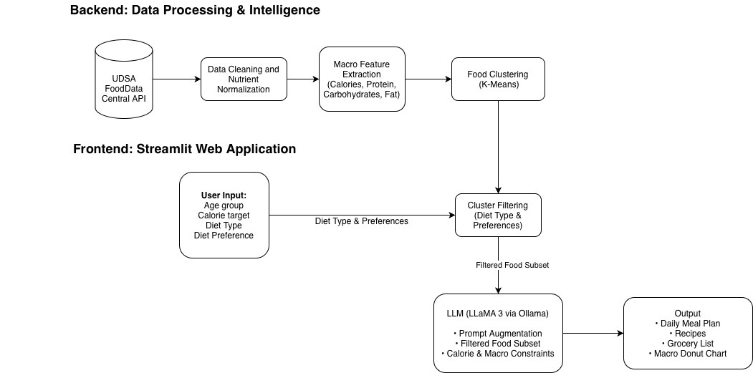
SYSTEM ARCHITECTURE OVERVIEW

Slide 5

DATA OVERVIEW
  Primary Source: USDA FoodData Central API.
  ~20,000 items, reduced to 19,000 cleaned food records.
  Key Features: calories, protein_g, carbs_g, fat_g, fiber_g.
  Engineered ratios: calorie-to-protein, macro percentages.

Slide 6
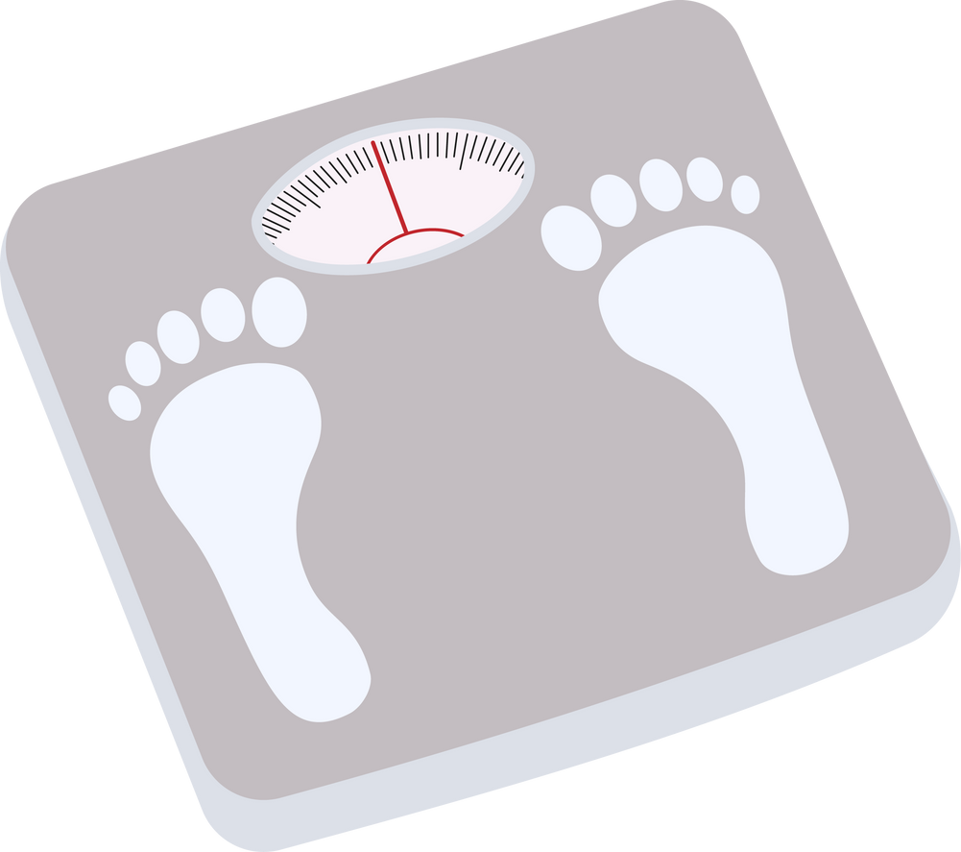
DATA CLEANING PIPELINE
  Dropped all-null columns (sugar_g)
  Median imputation for partial missing values
  Calorie recomputation formula: Calories=4×(protein+carbs)+9×fat
  Scaled using z-score normalization

Slide 7
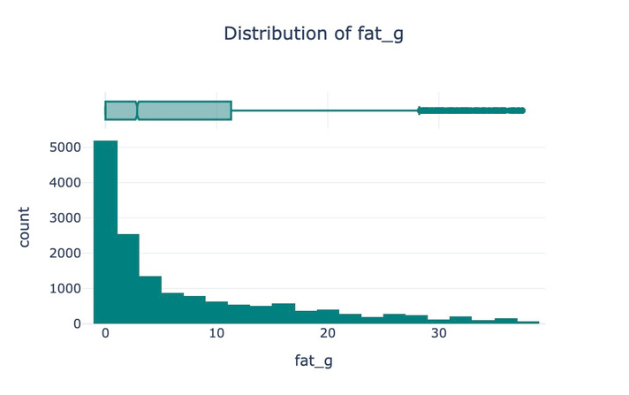
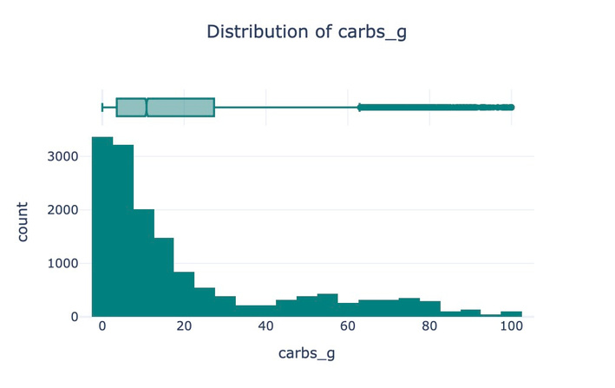
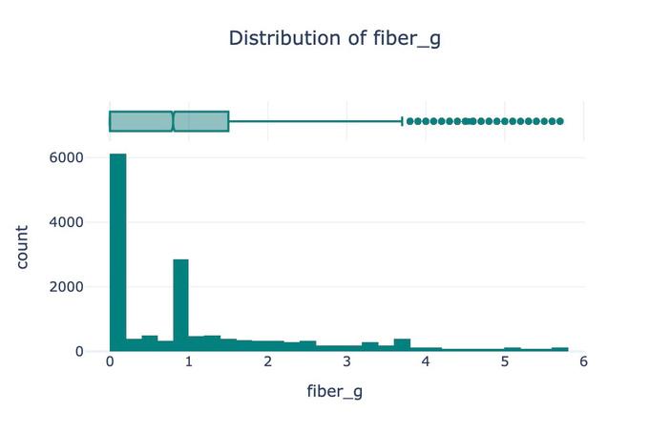
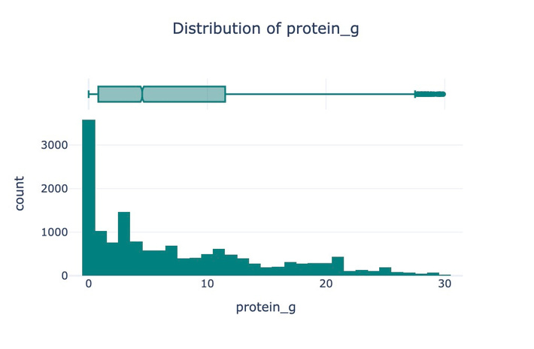
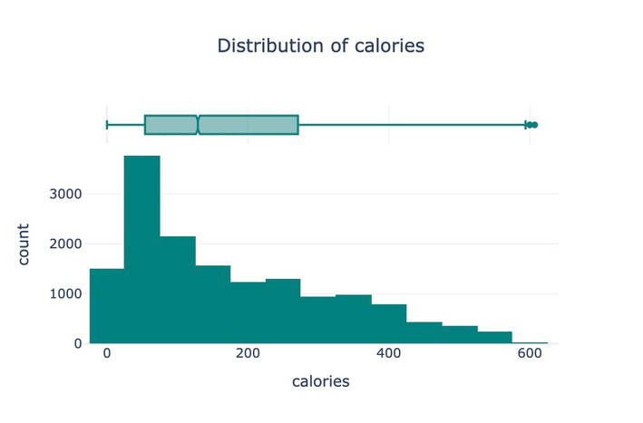
EDA
All nutrient distributions are right-skewed, showing that most foods are low in calories, fat, carbs, protein, and fiber, with a few high-value outliers.

Slide 8
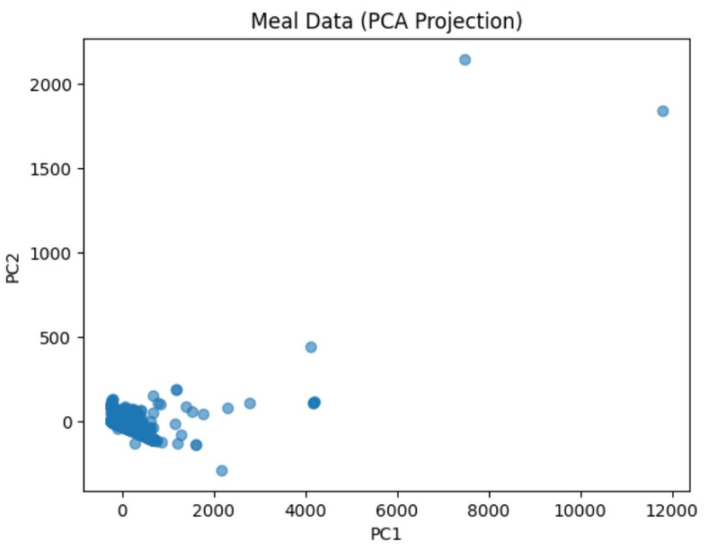
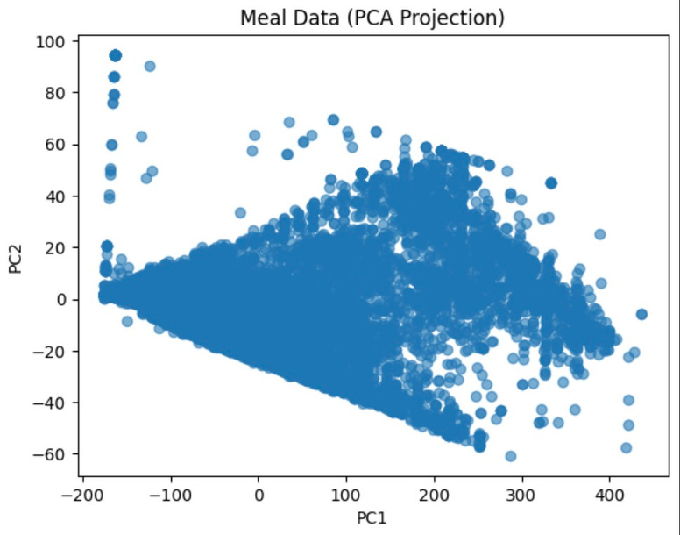
PCA ANALYSIS
Before Cleaning: After Cleaning:
Outliers distorted variance (one Compact, balanced distribution.
extreme point).
Data heavily skewed by high-calorie Nutrient patterns clearly visible for foods. sclustering.

Slide 9
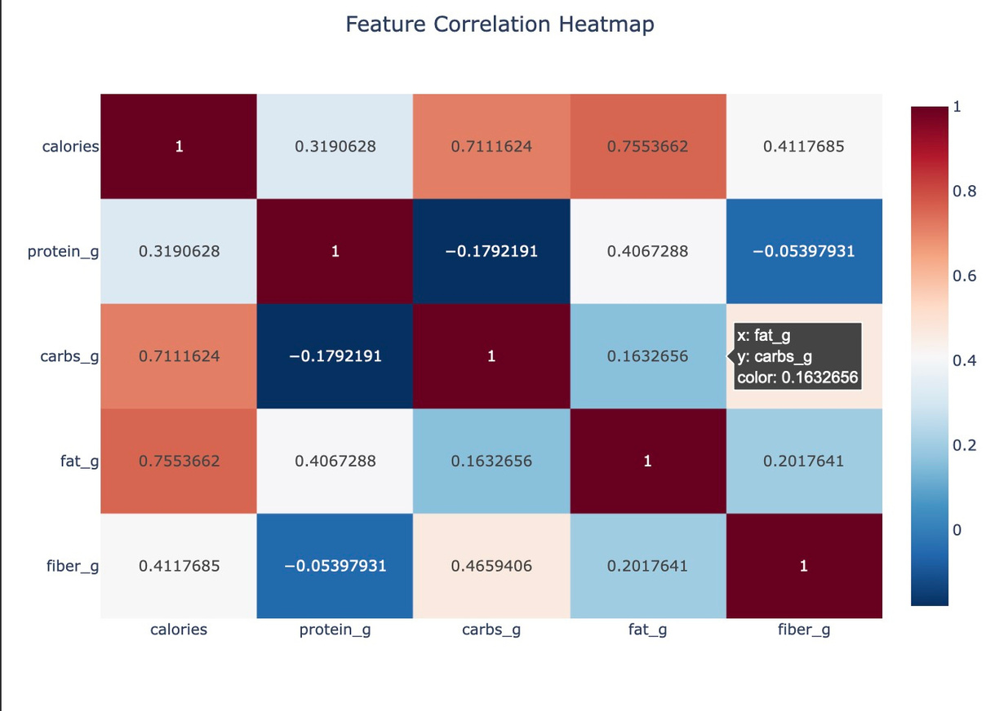
CORRELATION HEATMAP
Calories show strong positive correlations with fat (r ≈ 0.76) and carbs (r ≈ 0.71), indicating these nutrients are the main contributors to energy content.

Slide 10
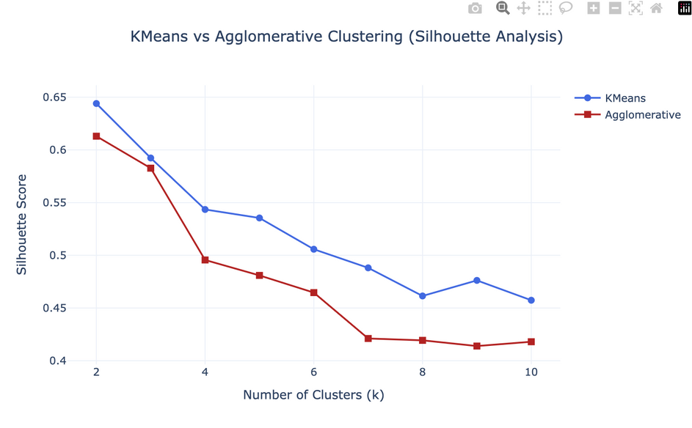
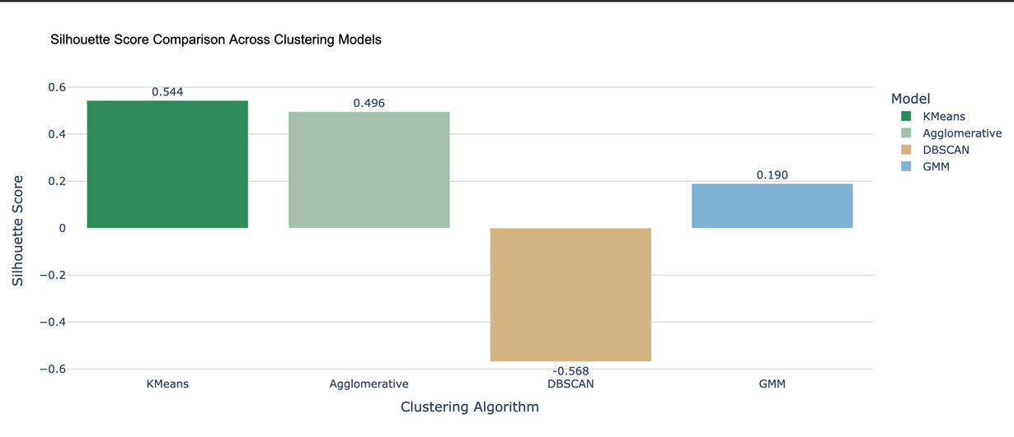
MODELING APPROACH & CLUSTER INSIGHTS
Evaluated model quality using:
  Silhouette Score
  Elbow Method
Final choice: K-Means with k = 4 clusters

Slide 11
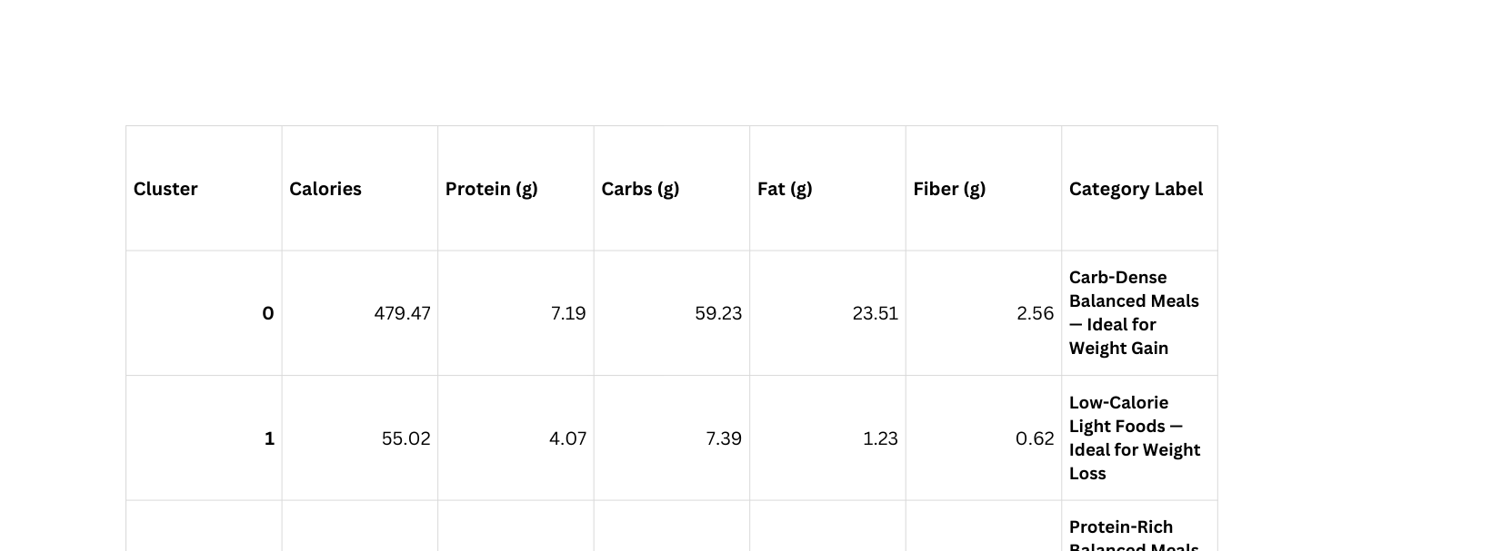
FINAL CLUSTERS
Cluster names were assigned based on the mean nutrient values within each cluster, reflecting their dominant nutritional characteristics.

Slide 12

INTEGRATION WITH LLM
  Used structured prompt containing cluster stats + calorie targets + age group + use preference.
  LLM generated:
3 meals per day.
Recipe descriptions, Grocery list.
Macro details.
  Ensures contextual consistency with nutrition data.

Slide 13
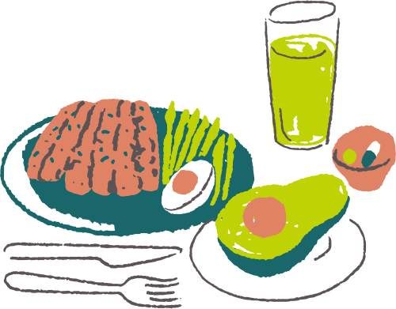



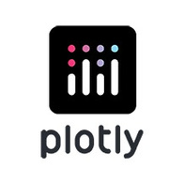


TECH STACK
Frontend Core Application & Orchestration
──────────── ──────────────
Machine Learning & LLM Visualization
──────────── ────────────
LLaMA 3 via Ollama
Data Source
────────────
FoodData Central API

Slide 14
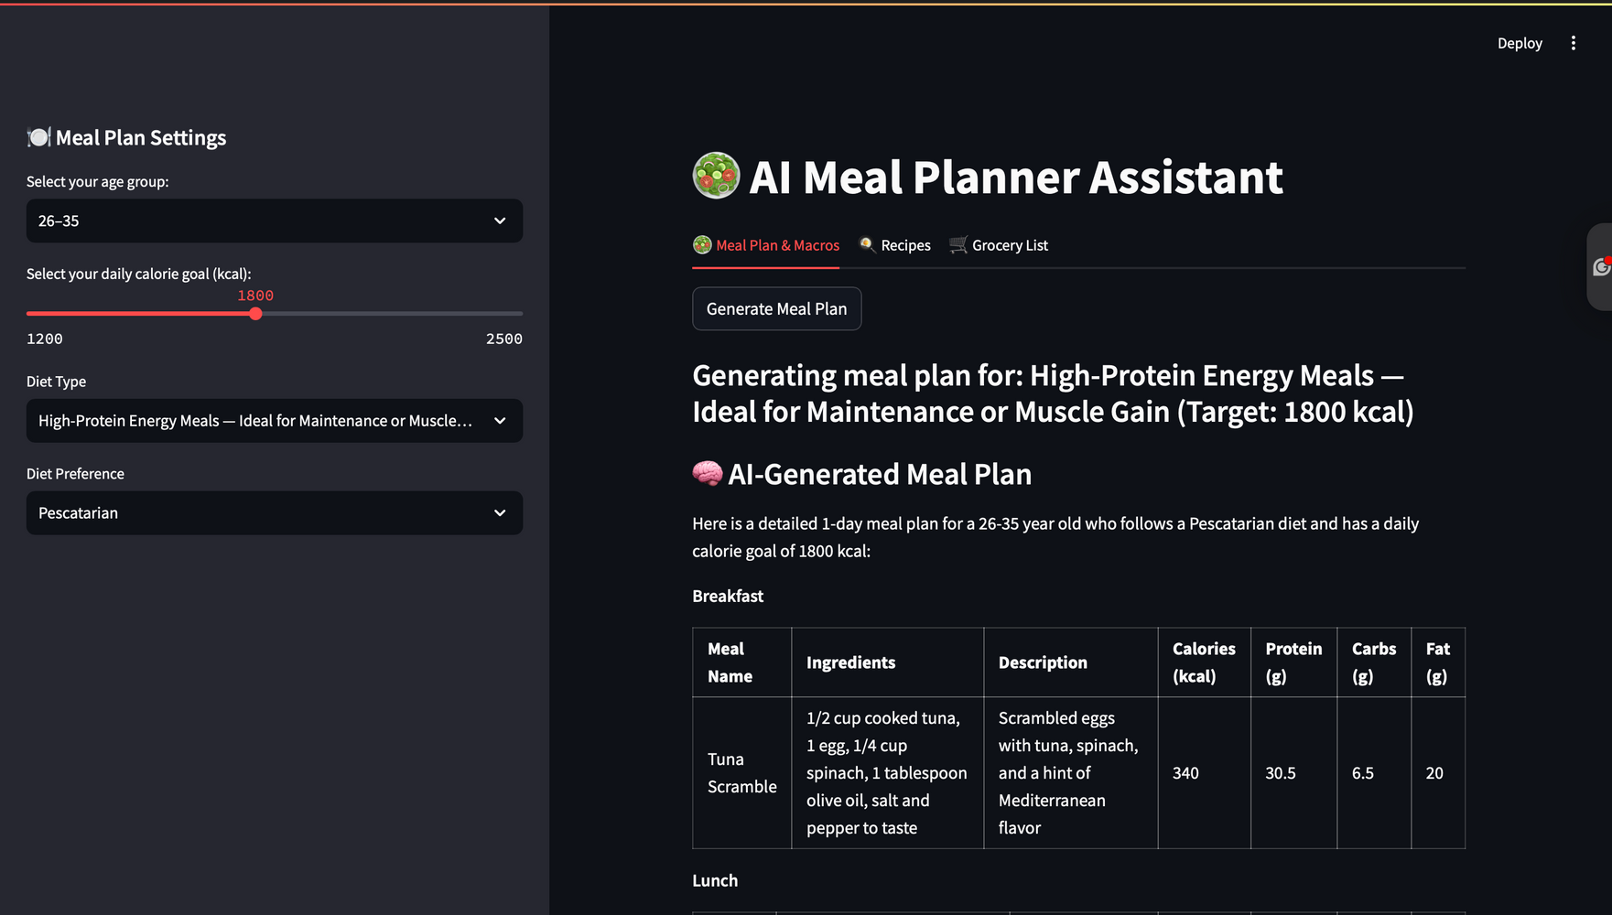
STREAMLIT WEB APP
  Built interactive dashboard for user-friendly planning.
  Generates visual macros with Plotly.

Slide 15
APPLICATIONS
LIMITATIONS
  Personal & fitness nutrition apps
  Healthcare diet planning
  Wellness and lifestyle platforms
  Limited to USDA foods
  Macros only, no micronutrients
  LLM portion estimates may vary
LESSONS LEARNED
FUTURE WORK
  Cleaning & scaling = better clustering
  ML + LLMs → human-like nutrition insights
  Add global food data
  Streamlit cloud deployment
  User feedback & mobile app
  Fine-tune LLM for nutrition

Slide 16
THANK YOU

